Slide 1
ALD Process for Top-Gating 2D Materials ENGR241 Autumn
Akash, Jung-Soo
Mentors: J, Michelle, Vijay

Slide 2
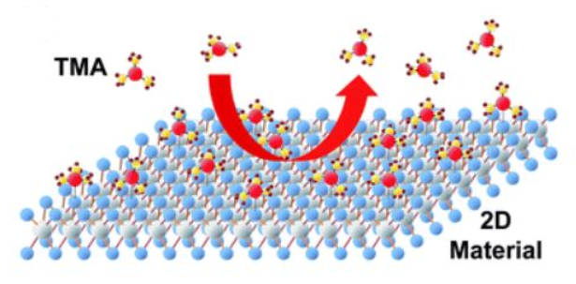
Recap
Uniform and full coverage of high-k gate dielectrics on MoS2
Essential for top-gated 2D device structure
No recipe exists in SNF for depositing high-k on 2D
Only Al has been tried from ALD tool in Pop lab (not in SNF)
Seed layer thickness has to be optimized
Film quality has not been characterized
Goal: Develop process flow for ALD top-gating on 2D for reliable and controlled growth of high-k materials

Slide 3
Deliverables this quarter
1. Aluminum seed layer thickness:
roughness, film uniformity, electrical characteristics (C-V)
2. Plasma VS Thermal ALD on:
Roughness, film uniformity, electrical characteristics (C-V)
3. Oxidized seed layer VS thickness and number of cycles
4. Device process for top-gated 2D FET for I-V curve
Start making devices from December

Slide 4
Device Process for I-V measurement
Thermal SiO2 (90nm) on Si
CVD grown MoS2
Spincoat (headway2)
Litho and develop (Heidelberg, headway2)
Seed layer deposition Al||Hf (AJA)
ALD
Gate electrode Ti/Au (AJA)
Liftoff
Process 3, 4 again
Top electrode Ti/Au (AJA)
Liftoff
I-V measurement
Concerns:
Residues (PR) may be present at the surface
Time consuming process
Will verify how long to expect before winter

Slide 5
Characterized Structures
N-type highly phosphorus-doped very low resistivity (0.01-0.09 Ω cm) wafers
This should be close to a MIM structure
10nm (100 cycles) thermal ALD alumina
No seed layer
Rest are stockroom I-test wafers: P-type boron-doped w/resistivity 0.1-0.9 Ω cm
AJA-deposited Al seed layer (nm) | Fiji2-deposited thermal alumina (nm)
0.5 | 5 (first)
1 | 5
1.5 | 5
0.5 | 10 (second)
1 | 10
1.5 | 10
2 | 10
2 | 10

Slide 6
Back-gate contact
Scratch surface for probe
Breakdown MIM structure
Use broken-down MIM structure as back-gate contact
Advantage: physically closer to structures being tested so less IR drop

Slide 7
Breakdown I-V Curves

Slide 8
Breakdown I-V Curves

Slide 9
Breakdown I-V Curves

Slide 10
Breakdown I-V Curves

Slide 11
Breakdown I-V Curves

Slide 12
Breakdown I-V Curves

Slide 13
Breakdown I-V Curves

Slide 14
Breakdown I-V Curves

Slide 15
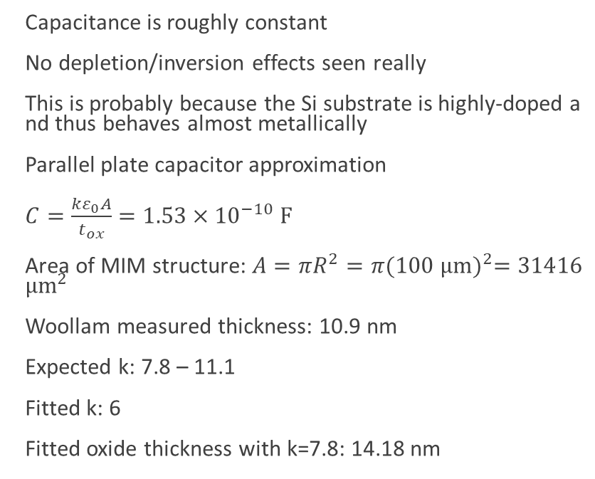
MIM: 10 nm ALD alumina (no seed)
Capacitance is roughly constant
No depletion/inversion effects seen really
This is probably because the Si substrate is highly-doped and thus behaves almost metallically
Parallel plate capacitor approximation
$C=\frac{kε_{0}A}{t_{ox}}=1.53×{10}^{−10} F$
Area of MIM structure: $A=πR^{2}=π{(100 μm)}^{2}=31416$ $μm^{2}$
Woollam measured thickness: 10.9 nm
Expected k: 7.8 – 11.1
Fitted k: 6
Fitted oxide thickness with k=7.8: 14.18 nm

Slide 16
C-V Curves

Slide 17
C-V Curves

Slide 18
C-V Curves

Slide 19
C-V Curves with Possible Soft Breakdown

Slide 20
C-V Curves with Possible Soft Breakdown

Slide 21
TODOs on data analysis
Will fit C-V curves to determine doping density and oxide capacitance
Will plot breakdown voltage as a function of seed/oxide thickness
Will try to fit breakdown behavior in soft breakdown regime

Slide 22
Oxidized Al thickness
Total target thickness: 5, 10nm
ALD on seed layer deposited MoS2 samples based on table below
Seed layer | 0.5nm |  | 1nm |  | 1.5nm |  | 2nm
After Oxidized | 1.00 | 1.02 | 1.76 | 1.79 | 2.72 | 2.59 | 3.75 | 3.87
After Oxidized | 1.01nm |  | 1.77nm |  | 2.65nm |  | 3.81nm

Slide 23
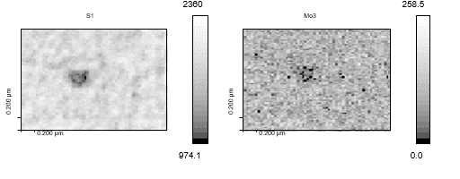
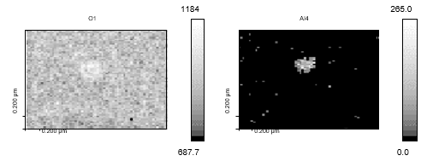
Auger Imaging (5nm w/o seed, 2um view)

Slide 24
AFM images (zoomed in – 500nm)
0.5nm
1nm
1.5nm
2nm

Slide 25
Seed layer on 2D
Using AJA Al dep rate: 0.2Å/s
Large area view: 5um^2
Small area view: 500nm^2
Roughness(nm) | 1 |  | 2 |  | 3 |  | Average
Al | large | small | large | small | large | small | large | small
0nm |  |  |  |  |  |  |  | 0.2nm
0.5nm | 0.19 | 0.16 | 0.33 | 0.19 | 0.31 | 0.20 | 0.27 | 0.18
1nm | 0.88 | 0.61 | 0.91 | 0.45 | 0.96 | 1.06 | 0.92 | 0.71
1.5nm | 1.50 | 0.50 | 0.54 | 0.63 | 0.71 | 0.31 | 0.92 | 0.48
2nm | 1.54 | 0.57 | 1.06 | 0.68 | 1.14 | 0.79 | 1.25 | 0.68

Slide 26
AFM images
Total 5nm w/o seed
Total 10nm w/o seed
Total 10nm w/ seed(2nm)
Scan Area (500nm^2) | Total 5nm | Total 10nm | Total 10nm (2nm)
Roughness (nm) | 1.036 | 0.914 | 0.602

Slide 27
AFM data
Thicker seed layer → rougher surface
With seed layer, roughness decreases
Thought: Seed layer makes more nucleation sites
More will be done with other seed layer thicknesses

Slide 28
Budget
item | cost
woollam | 607.51
wbclean-1 | 112.5
Wafer - I-test (100 mm) | 187
Tweezers - Teflon-coated | 48
Tweezers - Pointed | 24
Tweezer box - Small | 1
SNF General | 240
Scriber - Diamond | 30
Gold (Au) - aja-evap (nm) | 36.8
Gel Pak | 6
fiji2 | 1229.2
Cassette (storage) - 100 mm | 17
aja-evap | 396.08
afm-asylum | 683.67
AFM Tip - Standard Tapping | 225
 | 3843.7

Slide 29
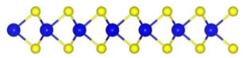
Seed Layer on MoS2
SEM, AFM
Seed layer
Oxidized seed layer
SiO2
AJA
SiO2
Air
SiO2
Si
Si
Si
Metal Oxide
Oxidized seed layer
Oxidized Seed layer
SEM, AFM
SiO2
ALD
SiO2
SEM, AFM, CV
Iteration with more samples
Si
Si

